Slide 1
LEARNMATE-COURSE ADVISOR agent
CAPSTONE PROJECT
Presented By:
Student name : Sudip Mitra
College Name & Department : Swami Vivekananda Institute of Science & Technology [Department of Electronics and Communication Engineering]

Slide 2
OUTLINE
Problem Statement
Technology used
Wow factor
End users
Result
Conclusion
Git-hub Link
Future scope
IBM Certifications

Slide 3
Problem Statement
Students often struggle to identify the right learning path that aligns with their interests and long-term goals due to the overwhelming number of online courses and a lack of personalized guidance. LearnMate aims to solve this by acting as an Agentic AI coach that interacts with students, understands their interests (like Frontend Development, Cybersecurity, UI/UX Design, etc.), assesses their current skill level, and dynamically builds a personalized course roadmap that adapts over time based on progress and preferences.
Proposed Solution: An AI-powered education advisor, LearnMate, built using IBM Watsonx.ai and RAG (Retrieval-Augmented Generation), to recommend personalized course pathways based on custom data uploaded by the user.

Slide 4
Technology used
IBM Cloud Lite Services
IBM Watsonx.ai Studio
IBM Granite Foundation Model
Retrieval-Augmented Generation (RAG)

Slide 5
IBM cloud services used
IBM Cloud Watsonx AI Studio
IBM Cloud Watsonx AI runtime
IBM Cloud Agent Lab
IBM Granite foundation model

Slide 6
Wow factors
Personalized learning roadmap generation
Context-aware recommendations using uploaded syllabus
Adapts to interests: AI, Cybersecurity, UI/UX, etc.
Easy to scale across universities or institutions
Voice and multilingual capabilities (future scope)

Slide 7
End users
Students
Academic Counselors
Colleges & Universities
Career Mentors / Coaching Institutes
E-learning Platforms

Slide 8
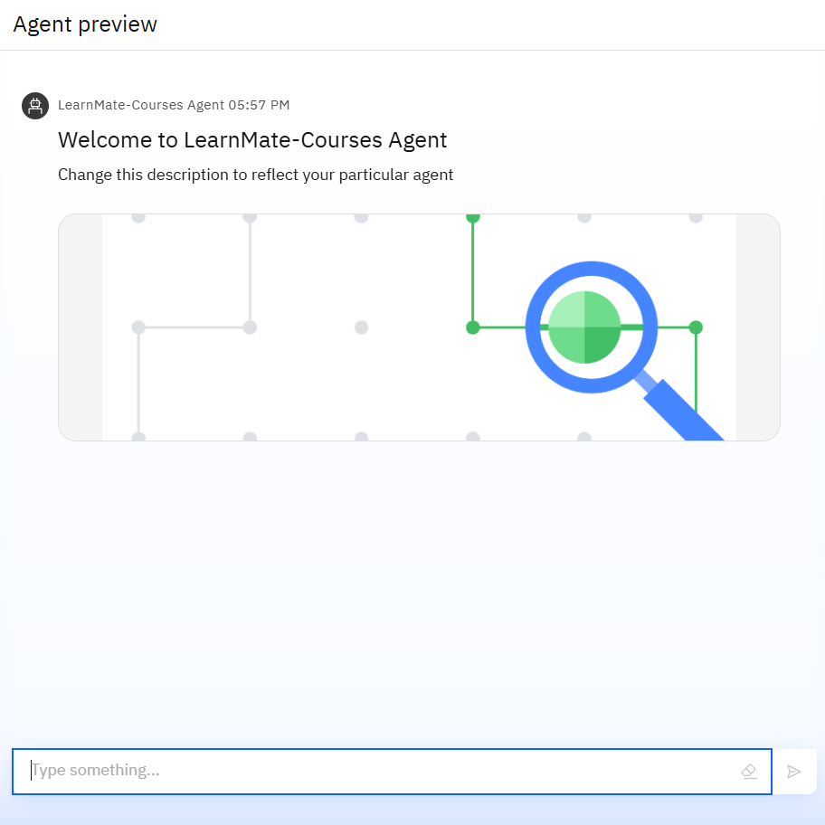
Results

Slide 9
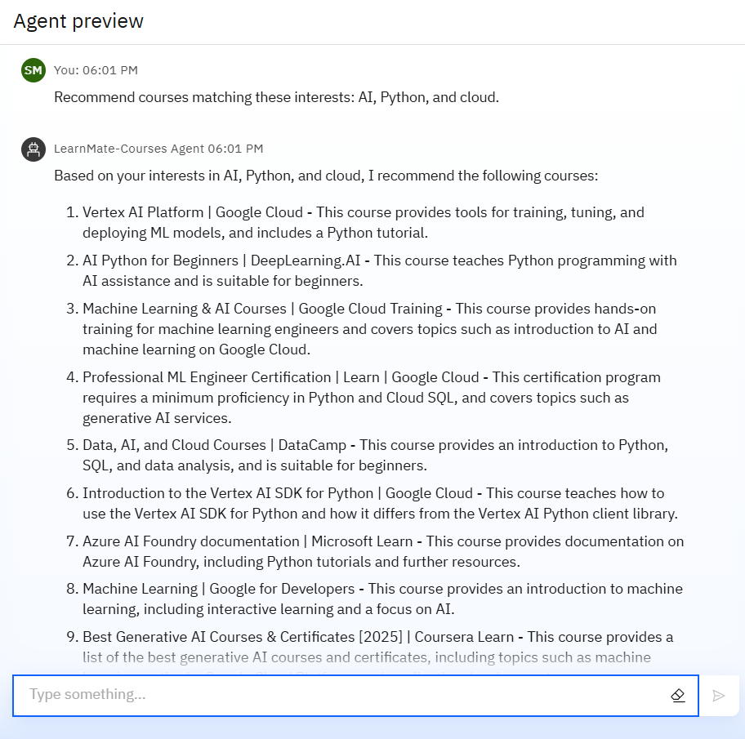
Results

Slide 10
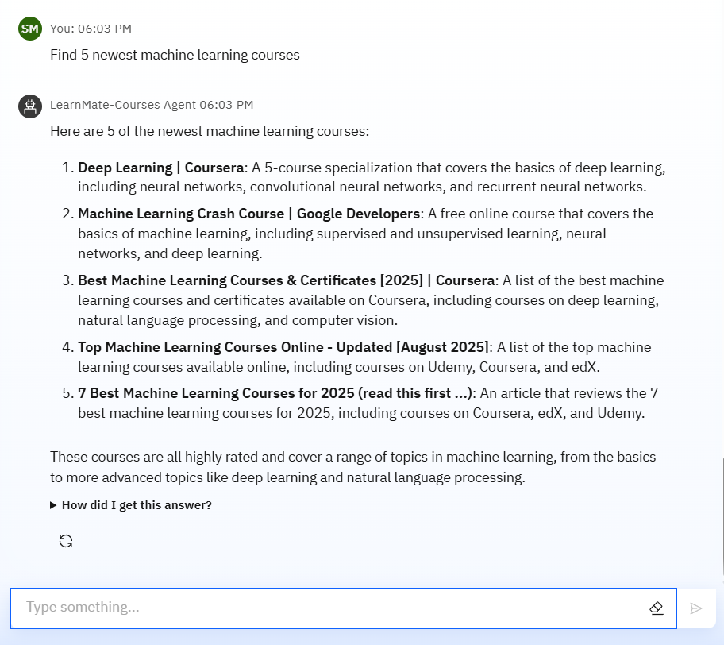
Results

Slide 11
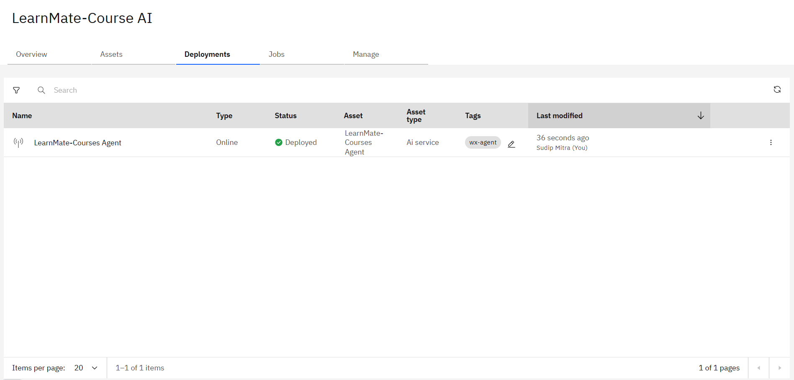
Results
Deployed AI Agent

Slide 12
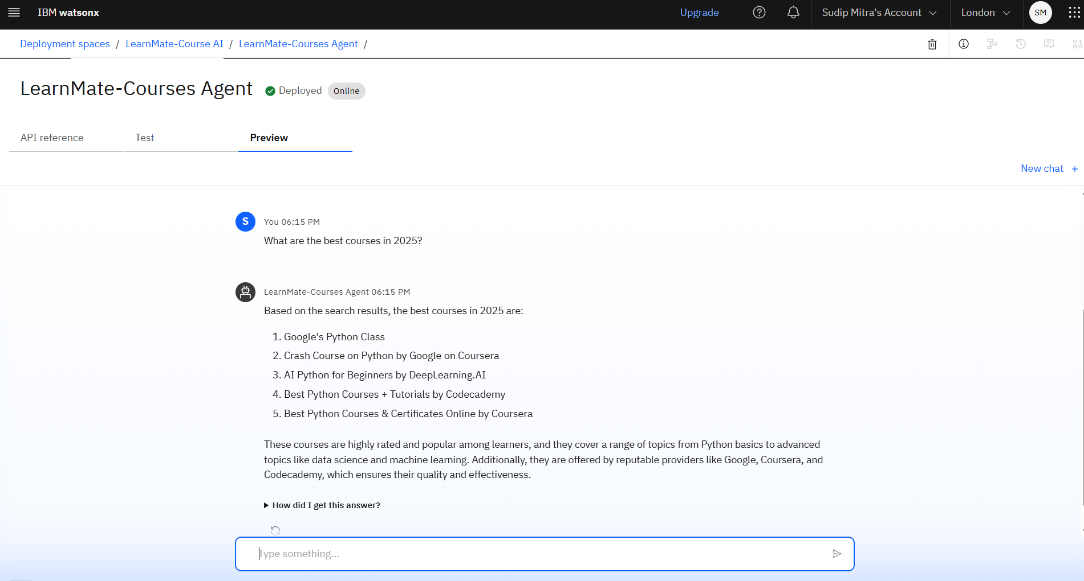
Results
Deployed AI Agent

Slide 13
Conclusion
This project successfully demonstrates how an AI agent can assist students in choosing personalized learning paths tailored to their interests and current skill levels.
Using IBM Watsonx and Granite LLM, the system intelligently recommends relevant courses from a predefined dataset.
The agent interacts smoothly with users, understands their goals, and dynamically builds a suitable course roadmap.
It simplifies decision-making for learners and supports continuous progress through AI-driven recommendations.

Slide 14
Future scope
Integration with LMS platforms (like Moodle or Google Classroom) for real-time course mapping.
Voice-based interaction using speech-to-text for accessibility.
Gamification and progress tracking to motivate learners.
Skill assessment modules using quizzes and interactive tests.
Recommendation of career pathways based on performance trends.
Multilingual support for diverse learner backgrounds.
Mobile app development for anytime, anywhere learning.

Slide 15
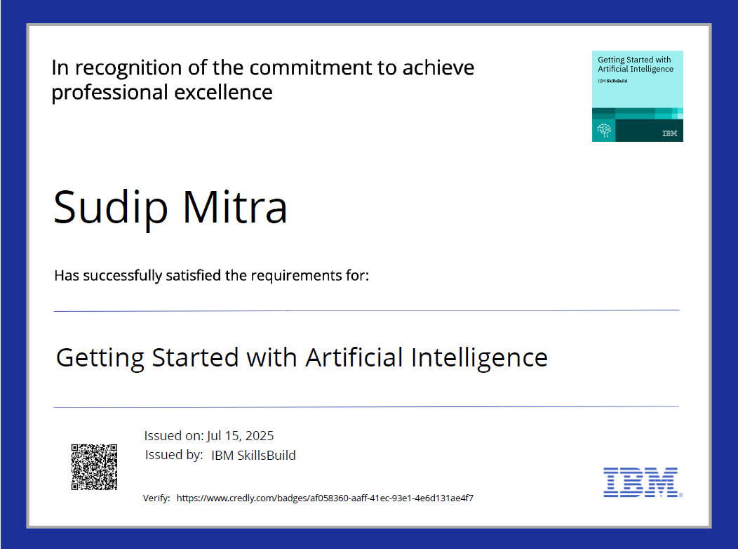
IBM Certifications

Slide 16
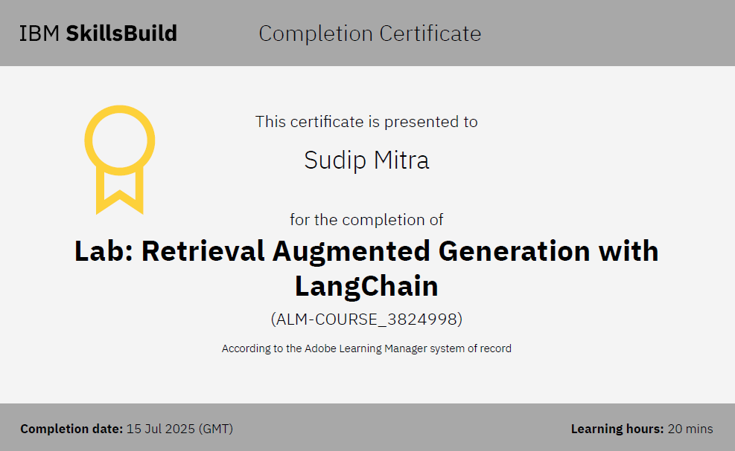

Slide 17
THANK YOU

